Slide 1
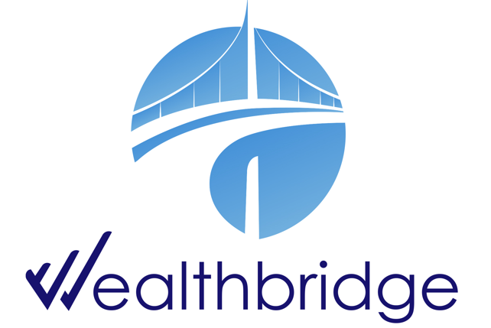
WEEKLY
BRIEF
Week of 9th – 13th February 2026
Wealthbridge Economic Advisory

Slide 2
NEWS HIGHLIGHTS
Key Highlights During the Week
International News
Local News
United States: Strong Labor Market and Easing Inflation Send Mixed Signals on U.S. Monetary Policy Path
UK & Eurozone: Eurozone Growth Steady, UK Expansion Slows Amid Political Uncertainty
China: China Faces Persistent Deflation, Stocks Edge Up Amid Policy Support
Japan: Yen Strengthens and Wages Slip as Bond Yields Steady; Stocks Surge on LDP’s Landslide Victory
Egypt : Inflation Eases to 10.1%; EU Grants €125m for Renewable Energy
Ghana : Inflation Falls to 3.8% Amid Rising Food Insecurity; Poultry Master Plan Targets Import Reduction by 2026
Nigeria Inflation Sentiment Moderates Slightly Amid Ongoing Energy and FX Pressures
Nigeria’s High Yields Attract $1.6bn Portfolio Surge, Boosting FX Liquidity
Nigeria Records $21bn Inflows in 10 Months Amid Trade Expansion and Investment Drive
Execution Gaps Undermine Nigeria’s Social Intervention Programmes Despite Large Budget Allocations
Jumia Shares Drop 15% Despite Strong Nigerian Growth as Profitability Timeline Remains Unchanged
SEC Urges Civil Servants to Invest, Boost Retirement Security, and Participate in Nigeria’s Growth
Key Macroeconomic Indices
NAFEM (₦/$) | Monetary Policy Rate | Brent Crude oil price ($/Barrel) | Inflation Rate | GDP Growth Rate
N1,354.92/$1 (06/02/26) | 27.00% (Dec 2025) | $67.60 (06/02/26) | 15.15% (Dec 2025) | 3.98% (Q3 2025)

Slide 3
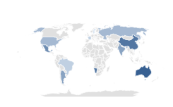

Global Economy
& Markets
The United States
Strong Labor Market and Easing Inflation Send Mixed Signals on U.S. Monetary Policy Path
U.S. hiring remained resilient in January, with 130,000 jobs added and unemployment declining to 4.3%, signaling continued labor market strength. The stronger-than-expected data reduced expectations for near-term monetary easing, with the probability of the Federal Reserve holding rates steady through June rising from 25% to over 40%. The report suggests that robust employment conditions may delay anticipated rate cuts, reinforcing a cautious outlook for financial markets.
U.S. headline inflation eased to 2.4% year-over-year in January, with monthly CPI rising 0.2%, supported by lower energy prices. However, core inflation accelerated to 0.3% month-over-month, signaling persistent underlying price pressures.
Meanwhile, retail sales stagnated and control group sales declined 0.1%, pointing to potential softening in consumer demand and adding complexity to the Federal Reserve’s policy outlook.
US Manufacturing PMI
Source: Trading Economics, WealthBridge Research
What to Expect
Strong U.S. job growth (130,000 added; unemployment 4.3%) and easing inflation (2.4% YoY) point to a resilient economy. The Federal Reserve is likely to delay rate cuts amid mixed signals from consumer spending.
Indices’ Performance
U.S. Stocks Slide on AI Disruption Fears as Value Outperforms Growth
S&P 500 | 6,835.71 | 1.39% 
Nasdaq Composite | 22,545.11 | 2.10% 
Dow Jones Industrial average | 49,469.8 | 1.23% 
Drivers
U.S. stocks declined this week amid concerns over the disruptive impact of artificial intelligence, with the Nasdaq Composite falling 2.10%, while the S&P 500 and Dow Jones shed 1.39% and 1.23%, respectively. The S&P MidCap 400 showed relative resilience, dropping only 0.66%. Value stocks continued their strong run, outperforming growth for the seventh consecutive week and extending their year-to-date lead to over 11 percentage points.
U.S. stocks declined this week, driven by investor concerns over AI disrupting industries, tech and growth stock weakness, and a continued rotation toward value and mid-cap stocks.

Slide 4

Global Economy
& Markets
UK & Eurozone
Eurozone Growth Steady, UK Expansion Slows Amid Political Uncertainty
The Eurozone economy grew 0.3% in Q4 2025, bringing annual growth to 1.5%, with Spain leading regional expansion. Employment rose 0.2% quarter-over-quarter, though France’s unemployment climbed to 7.9%, highlighting uneven labor market conditions. Meanwhile, German wholesale prices increased 1.2% YoY, driven by metals and food, signaling moderate inflationary pressures across the region.
The UK economy grew modestly in Q4 2025, with GDP rising 0.1% quarter-over-quarter and 1% year-over-year, as manufacturing expanded but construction declined. Retail sales increased 2.3% YoY in January, their fastest growth since last August, reflecting resilient consumer demand. Political uncertainty surrounding Prime Minister Keir Starmer weighed on investor sentiment, keeping market confidence in check.
Eurozone GDP Growth
What to Expect
The Eurozone shows steady but uneven growth with rising employment and moderate inflation, while the UK grows slowly and investor confidence is dampened by political uncertainty.
Source: Trading Economics, WealthBridge Research
STOXX Europe 600 Ends Week Flat Amid Mixed Global Signals
Drivers
Indices’ Performance
European markets were volatile this week, with the STOXX Europe 600 eking out a 0.09% gain despite hitting a new high. Germany’s DAX rose 0.78%, France’s CAC 40 gained 0.46%, the UK’s FTSE 100 added 0.74%, while Italy’s FTSE MIB declined 0.97%. Investors reacted to stronger-than-expected U.S. jobs data and growing concerns over AI disruption, creating uneven performance across the region.
European markets were driven by strong U.S. jobs data, AI disruption concerns, and uneven country performance, resulting in volatility and a modest net gain for the STOXX Europe 600.
FTSE 100 | 10,436.06 | 0.74% 
DAX index | 24,914.88 | 0.78% 
CAC 40 | 8,309.98 | 0.46% 
FTSE MIB | 45,449.12 | 0.97% 

Slide 5

Global Economy
& Markets
Asia
China Faces Persistent Deflation, Stocks Edge Up Amid Policy Support
China’s consumer inflation eased to 0.2% YoY in January, while producer prices remained in deflation for the 40th consecutive month, reflecting ongoing disinflationary pressures. The property market showed tentative stabilization, with resale home prices falling 0.54% and new home prices down 0.4%, marking smaller declines than previous months. The People’s Bank of China pledged a moderately loose monetary policy in 2026, signaling potential further rate and reserve requirement cuts to support domestic demand and key sectors.
Chinese stocks ended the week modestly higher, with the CSI 300 up 0.39% and Shanghai Composite up 0.43%, as investors positioned cautiously ahead of the Lunar New Year holidays.
China Foreign Exchange Reserves
What to expect
Investors can expect modest stock market gains ahead of the Lunar New Year, supported by the People’s Bank of China’s accommodative policies.
Shanghai Composite | 4,084.81 | 0.43% 
Hang Seng Index | 26,560.48 | 3.24% 
Nikkei 225 index | 56,954.81 | 4.96% 
Yen Strengthens and Wages Slip as Bond Yields Steady; Stocks Surge on LDP’s Landslide Victory
Following the Liberal Democratic Party (LDP) election victory, the 10-year Japanese government bond yield settled at 1.23%, little changed from the prior week, as investors welcomed assurances on funding consumption tax cuts without new debt. The yen strengthened to around JPY 153/USD after government verbal intervention emphasizing policy discipline. Meanwhile, real wages fell 0.1% YoY in December, highlighting ongoing pressure on household incomes despite stable monetary and fiscal conditions.
Japanese stocks surged after the LDP’s landslide victory fueled expectations of aggressive fiscal stimulus, tax cuts, and higher defense spending.
Drivers
Japan’s economic and market momentum was driven by the LDP’s decisive election victory, which boosted expectations of aggressive fiscal stimulus and higher defense spending, alongside a strengthening yen and stable bond yields that reassured investors.

Slide 6
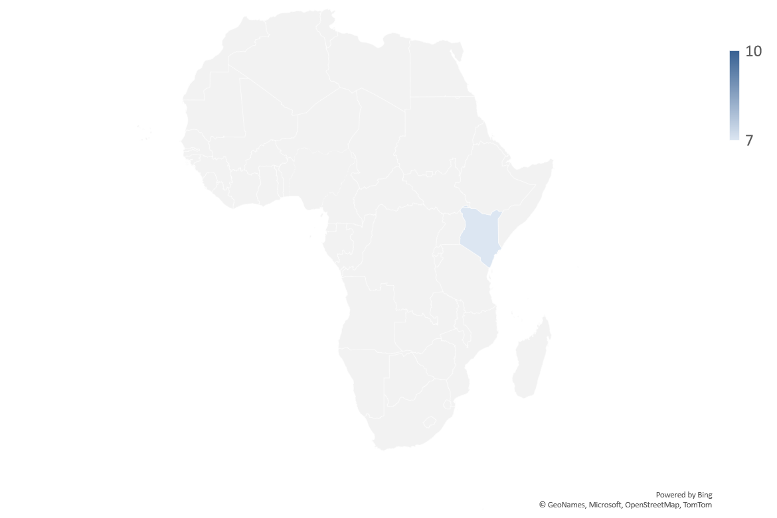


AFRICAN Economy
Inflation Eases to 10.1%; EU Grants €125m for Renewable Energy
Egypt’s annual inflation eased slightly to 10.1% in January 2026, down from 10.3% in December, according to CAPMAS. Monthly inflation rose 1.5%, driven by higher costs in food, housing, fuel, and clothing, while fruit prices fell 2.5%. Despite the moderation, inflation remains elevated, reflecting ongoing pressures on consumer prices.
The European Union approved €125 million in grants to strengthen Egypt’s renewable energy sector, with €90 million via the European Investment Bank for electricity network upgrades and €35 million to support Scatec’s green ammonia project in Ain Sokhna.
The grants are part of the 2024 EU-Egypt strategic partnership, providing funding, investment guarantees, and technical support for energy transformation. This initiative is expected to accelerate Egypt’s transition to clean energy and strengthen its energy infrastructure.
Inflation Falls to 3.8% Amid Rising Food Insecurity; Poultry Master Plan Targets Import Reduction by 2026
Ghana’s Ministry of Food and Agriculture has launched a poultry sector master plan with Agri-Impact Limited and the Mastercard Foundation, aiming to boost domestic production and cut reliance on imports by 2026. Domestic output currently meets only 18% of chicken consumption, highlighting the urgency of reform. The plan is expected to strengthen competitiveness, attract investment, and create jobs across the poultry value chain
Ghana’s annual inflation fell to 3.8% in January 2026, the lowest since 2021, marking 13 consecutive months of decline. Despite this macroeconomic improvement, food insecurity remains high at 38.1%, especially among rural and female-headed households. The data highlight a disconnect between overall economic gains and everyday living standards.

Slide 7

Domestic Economy and Markets Highlights
Snapshot of Key Macroeconomic Indicators
Indicators | Current | Previous
Inflation rate | 15.15% (Dec 2025) | 17.33% (Oct 2025) |  218 bps
MPR | 27.00% (Dec 2025) | 27.00% (Nov 2025) | ▬ 0 bps
Quarterly GDP Growth Rate | 3.98% (Q3 2025 y/y) | 4.23% (Q2 2025 y/y) |  591bps
Yearly GDP Growth Rate | 3.38% (FY 2024; y/y) | 3.04% (FY 2023; y/y) | ❐ 34 bps
GDP (Nominal) | N113.59 Trn (Q3 2025) | N100.73 Trn (Q2 2025) | ❐ 12.77%
Brent Crude oil price | $67.60 (13/02/26) | $67.91 (06/02/26) |  0.46%
Exchange rate (NAFEM W-O-W% , N/$) | N1,354.92/$1 (13/02/26) | N1,366.20/$1 (06/02/26) |  0.83%
Parallel Market FX Rate (IMTO) (N/$) | N1,420.48/$1 (13/02/26) | N1,440.81/$1 (06/02/26) |  1.41%
P2P (N/$) | N1,401/$1 (13/02/26) | N1,450/$1 (06/02/26) |  3.38%
External Reserve | $46.941 billion (13/02/26) | $46.912 billion (06/02/26) | ❐ 0.06%

Slide 8

Domestic Economy and Markets Highlights
Key Economy News
Nigeria Inflation Sentiment Moderates Slightly Amid Ongoing Energy and FX Pressures
Nigeria’s inflation expectations index declined marginally to 41.4 points in January 2026, signalling a slight improvement in business sentiment, although household expectations remain elevated.
Energy, transportation, exchange rate pressures, insecurity, and interest rates remain the key drivers of price perception. With headline inflation easing to 15.15% in December 2025, investors are watching upcoming data for confirmation of a sustained disinflation trend.
Nigeria’s High Yields Attract $1.6bn Portfolio Surge, Boosting FX Liquidity
Foreign portfolio investors boosted Nigeria’s FX inflows to $3.0 billion in January 2026, up 7% month-on-month, as high domestic yields attracted offshore capital. Portfolio inflows surged 151% to $1.6 billion, with nearly all directed into fixed-income securities, reinforcing improved liquidity conditions.
External reserves climbed to $46 billion, reducing pressure on the naira and limiting the need for heavy CBN intervention.

Slide 9

Domestic Economy and Markets Highlights
Key Economy & Fiscal News
Nigeria Records $21bn Inflows in 10 Months Amid Trade Expansion and Investment Drive
Nigeria recorded $21 billion in capital importation in the first 10 months of 2025, up sharply from $12 billion in 2024 and under $4 billion in 2023, signalling a strong rebound in investor confidence. The surge was driven by structured investment facilitation, expanded bilateral engagements, and growth in Special Economic Zones, with the UK accounting for about 65% of inflows.
As trade expands and exports rise, the Ministry of Industry, Trade and Investment is seeking a higher N2.72 billion capital budget for 2026 to sustain momentum.
Execution Gaps Undermine Nigeria’s Social Intervention Programmes Despite Large Budget Allocations
Nigeria committed hundreds of billions of naira to social intervention programmes in 2025 under Nigeria’s Social Intervention Programmes (NSIP), targeting up to 15 million vulnerable households.
However, only 8.1–8.5 million households received support, leaving roughly 43% unreached, due to delays in NIN verification, administrative bottlenecks, and weak monitoring.
Experts warn that improving budget execution and delivery systems is crucial to ensure these programmes meaningfully shield families from poverty.

Slide 10


Domestic Economy and Markets Highlights
Key Market News
Jumia Shares Drop 15% Despite Strong Nigerian Growth as Profitability Timeline Remains Unchanged
Shares of Jumia Technologies AG (NYSE: JMIA) fell 15% following its Q4 and full-year 2025 earnings, closing at $10.33, as investors remained cautious about the company’s profitability timeline.
Despite the drop, Nigeria remained Jumia’s strongest market, with 33% growth in orders and 50% growth in GMV, driving overall revenue up 34% year-on-year to $61.4 million.
The stock decline reflects broader investor focus on profitability and cash generation over growth, even as Jumia narrows losses and strengthens platform performance.
SEC Urges Civil Servants to Invest, Boost Retirement Security, and Participate in Nigeria’s Growth
The Securities and Exchange Commission (SEC) has called on civil servants to actively engage in the capital market to enhance financial security, build wealth, and benefit from national economic growth. Through the Contributory Pension Scheme (CPS), civil servants are already linked to market instruments such as bonds, equities, and infrastructure funds, but SEC proposes financial literacy programs, mutual funds, Real Estate Investment Trusts (REITs), and mortgage-backed securities to broaden opportunities.
Both the SEC and Head of Service, Dame Didi Walson-Jack, highlighted collaboration to ensure civil servants retire with adequate savings and assets, while warning against unregistered schemes like Ponzi operation

Slide 11







Domestic Markets
Equities Market
The Nigerian Equities Market Ended The Week Bullish
Sectoral Performances
Market Capitalisation: N117.027 tn ( 6.16% W-o-W)
All Share Index: 182,313.08 (6.16 % W-o-W)
Year-to-Date 17.16% ( 686 bps W-o-W)
Total Turnover (Trades): 4.652 bn ( 65.64 % W-o-W)
Value of Trades: N193.326 bn ( 20.52 % W-o-W)
Fixed Income Market
Bond Market
The Nigerian secondary bond market ended the week on a bullish note, supported by strong demand and robust trading activity across most maturities. Average yields on FGN bonds declined by 5 basis points to 16.12%, while sovereign Eurobond yields fell 7 basis points to 7.00%, reflecting solid investor confidence in both local and dollar-denominated government securities. Overall, heightened buying interest underscores sustained appetite for Nigerian fixed-income instruments amid market uncertainties.
Top Gainers & Decliners
NTB and Money Markets
System liquidity surged to N4.32 trillion last week, driven by OMO maturities, primary market settlements, and Deposit Money Bank (DMB) activities, easing short-term funding pressures. The average yield on secondary T-bills fell 8bps to 17.55%, while money market rates saw mixed movements: overnight Nigerian Interbank Offered Rate (NIBOR) eased slightly to 22.82%, and 6-month tenor dropped 9bps to 25.04%, reflecting investor positioning ahead of the upcoming large T-bills auction. Overall, sustained demand for money market instruments and short-term liquidity improvements supported softer yields across the curve.

Slide 12
MARKET OPPORTUNITIES
Capital Market and Corporate Advisory | With the SEC encouraging civil servants to participate in investments and rising FX inflows, there’s growing demand for financial education, investment planning, and portfolio advice. Companies and investors navigating FGN bonds, Eurobonds, NTBs, and treasury bills may need guidance on maximizing returns and managing liquidity risks.
ADVISORY
ASSET MANAGEMENT
Fixed-Income Investment Products Retail & Pension Fund Management | Strong demand for FGN bonds, NTBs, and Eurobonds shows investors are seeking low-risk, stable returns. Asset managers can create bond funds . With civil servants’ pension funds being invested in the market and rising FX inflows, there’s room to offer tailored mutual funds or retirement-focused portfolios.
Retail Lending | Increased liquidity and interest in short-term T-bills show households and small businesses are active savers; microfinance can offer short-term loans or asset-backed lending.
SME Financing | Small businesses are sensitive to inflation, energy, and exchange rate pressures. Microfinance institutions can provide working capital and trade finance to SMEs excluded from traditional banks.
MAINTRUST
MFB

Slide 13



For more info call:
+234 809 999 4372
E-mail address
info@wealthbridge.com.ng
Visit us at:
21, Bourdillon Road, Ikoyi, Lagos
100, Ademola Adetokunbo street, Wuse II, Abuja
Visit our website
www.wealthbridge.com,ng
6

